Slide 1
Microsoft Teams Apps – Advanced Techniques
Compose Extensions-

Slide 2

Compose Extensions-
Introduction to Compose Extensions
Deep-dive into building extension
Demo

Slide 3
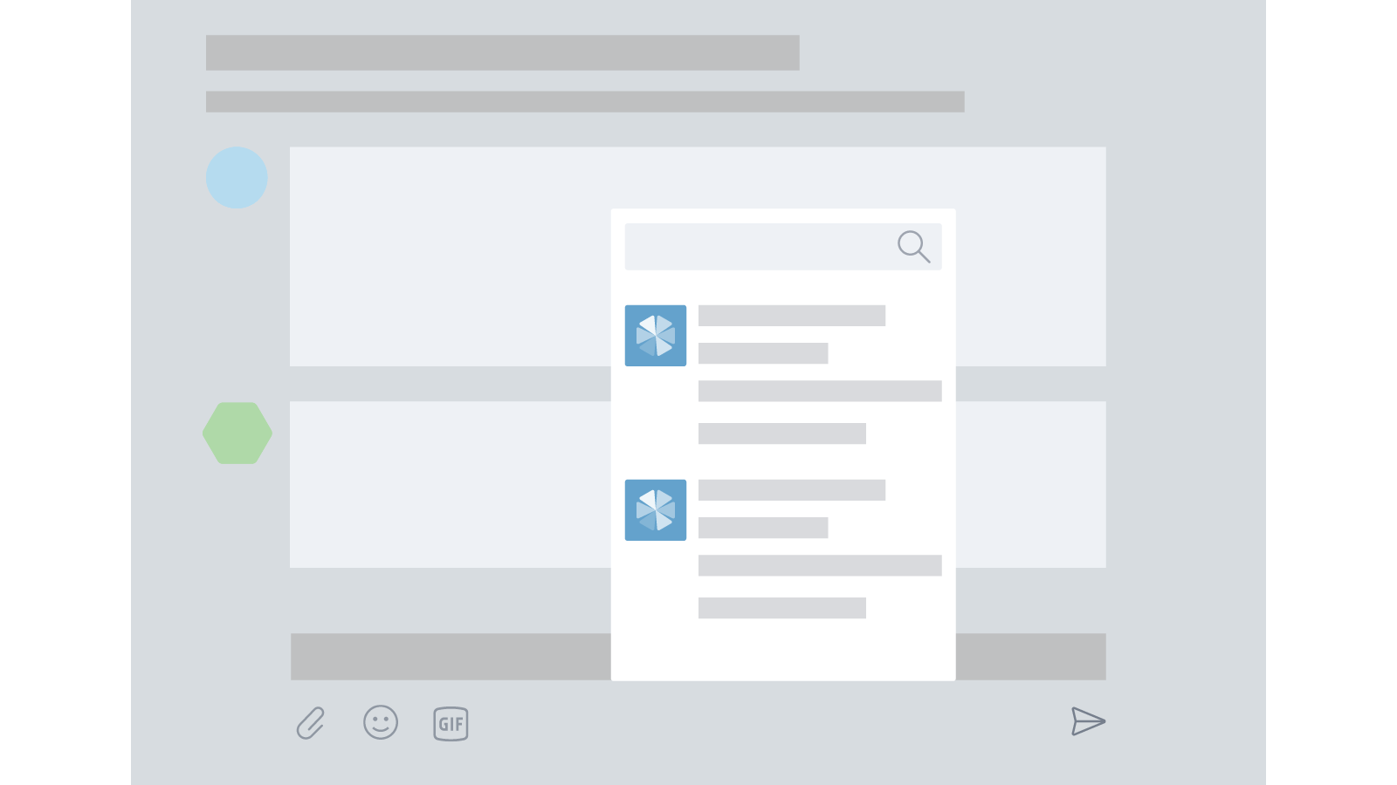
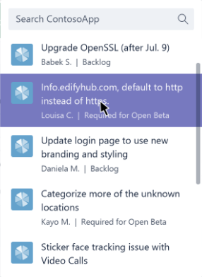
Introduction to Compose Extensions
Share your content in a channel or chat
Users select entity from your extension/app
Card added to message
Conversation is about an item in your service
Entity display is customizable
Initial display control
Automatic rendering & submission of search
You decide entities and render in cards

Slide 4
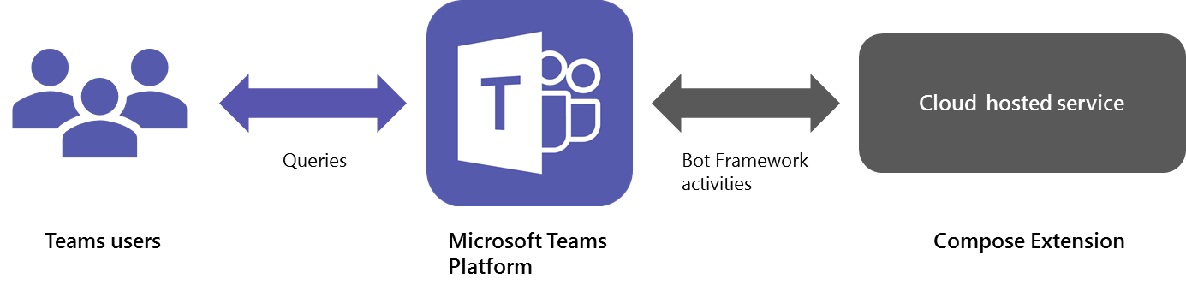
Deep-dive into building extension
Extends the compose window
Provides rich user interface for selecting information to include in message
Leverages bot communication (Activities, schema)
Notes:
At its core, a compose extension is a cloud-hosted service that listens to user requests and responds with structured data, such as cards. You integrate your service with Microsoft Teams via Bot Framework Activity objects. Our .NET and Node.js extensions for the Bot Builder SDK can help you add compose extension functionality to your app.

Slide 5
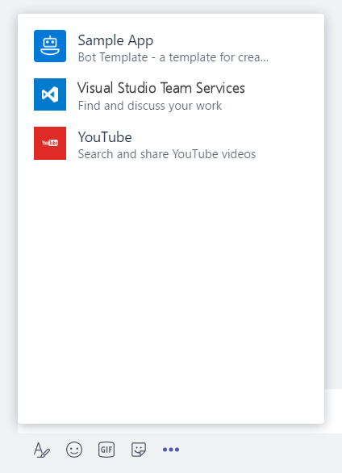
Deep-dive – Manifest
"composeExtensions": [ { "botId": "[MicrosoftAppId]", "scopes": [ "team" ], "canUpdateConfiguration": true, "commands": [ { "id": "searchCmd", "description": "Search Bot Channels", "title": "Bot Channels", "initialRun": false, "parameters": [ { "name": "searchText", "description": "Enter your search text", "title": "Search Text“ } ] } ] } ]
composeExtension node
Associated with a registered application
Personal and Team scopes
Define command UI and parameter
Multiple extensions
Your extension shown along with all others added to Teams
Notes:
commandExtension is part of the manifest.json file
Scope determines if 1:1 (personal) or channel (team)

Slide 6
Deep-dive – Command
Manifest properties describe command. UI is generated by Teams
Property name | Purpose
id | Unique ID that you assign to this command. The user request will include this ID.
title | Command name. This value appears in the UI.
description | Help text indicating what this command does.
initialRun | If set to true, indicates this command should be executed as soon as the user chooses this command in the UI.
parameters | List of parameters.
parameter.name | The name of the parameter. This is sent to your service in the user request.
parameter.description | Describes this parameter’s purposes or example of the value that should be provided. This value appears in the UI.
parameter.title | Short user-friendly parameter title or label.
Notes:
All are required except “initialRun”. Should included it for completeness, just set value to false.

Slide 7
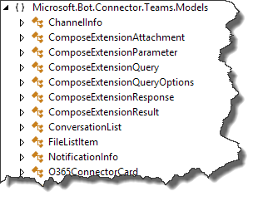
Deep-dive – Events
Activity payload
Type is invoke
Name identifies type of event
composeExtension/query
composeExtension/querySettingUrl
composeExtension/setting
Sent to registered bot endpoint
Teams Connector NuGet package provides detection methods and data models

Slide 8
Deep-dive – Events
Query events
Query data sent to bot
Activity.GetComposeExtensionQueryData()
Verify commandId and parameters
Use parameter value to query your service
Respond with attachment layout of “List”
Hero Card
Thumbnail Card
O365Connector Card

Slide 9
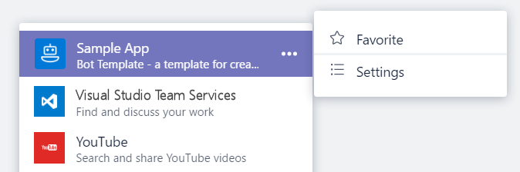
Deep-dive – Events
Settings events
If canUpdateConfiguration is true, Teams wil send Settings events in response to user action
onQuerySettingsUrl
Sent when “Settings” clicked
Return Url of settings page
Teams will render page
onSettingsUpdate
Sent when settings page is closed
Storage of settings is developer responsibility

Slide 10

Deep Dive – Other considerations
Authenticated requests to Extension service
Activity payload includes a Teams-generated id that represents the user
Activity payload includes Channel/Team/Tenant IDs
Authenticating users to your system
No tokens!
Response to query event can be auth command instead of result
Provide Url to page that initiates login/token acquisition
Developer must associate Token/UPN with Teams-provided ID

Slide 11
Demo Compose Extensions
Notes:
The demo extension searches against a list of channels supported by the bot framework. Type “sky” or “team” in the search box to find popular Microsoft channels

Slide 12

Summary

Slide 13
Thank you

